Slide 1

Post Graduation diploma project
PG-DAC
​
Learning Management System
​
Submitted By
​
Shailesh Agarmore 230343020005
Sushil Chaudhari 230343020023
Pranav Chirame 230343020024
Shantanu Mundhe 230343020060
​
Guide By : Dipali Jadhav

Slide 2
AGENDA
Introduction​
Architecture
​ER Diagram
Functionality
Technology platform used for project
User roles and responsibilities
Details of contribution of each team members
Use of GitHub
Conclusion

Slide 3
Introduction
1.Purpose of Project
The project provides an online platform for Manage Leaning System of any campus/school.
2. Need
The main motive to develop this Learning Management System to tract daily record and schedule the daily routine of campus.
3.Benificiaries of Project
The Project will be beneficial for Teacher and as well as Students to track daily schedule.

Slide 4
Project Architecture
Used for
User interfacing
Basic data validation
Used for
Server side validation
Response handling
Business Logic
Database operations
Used for
Permanent data storage
Database level validation
Database access using stored procedures
Front end Layer
Server Layer
Technologies used
HTML, CSS
JavaScript, jQuery
ReactJS
JSON
Database Layer
Technologies used
Spring boot
Hibernate
Technologies used
MySQL

Slide 5
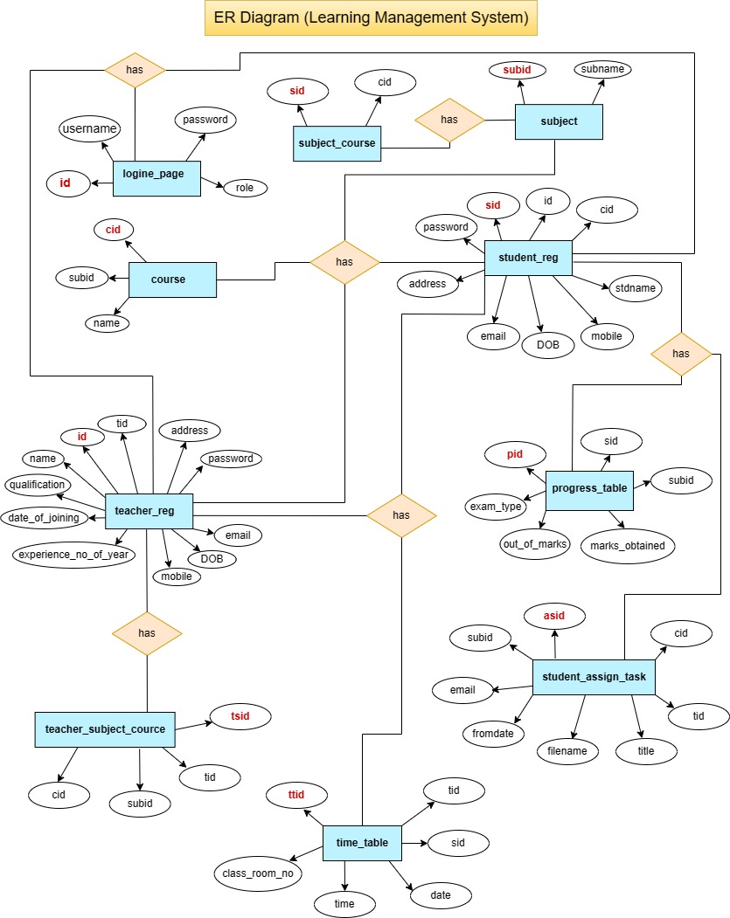

Slide 6
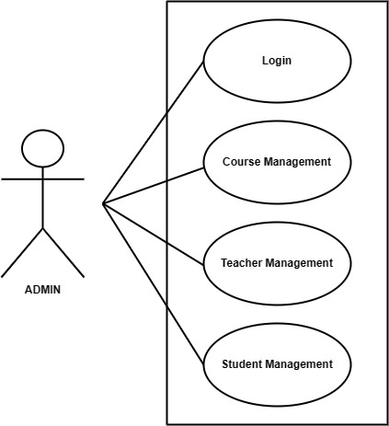
Functionality

Slide 7
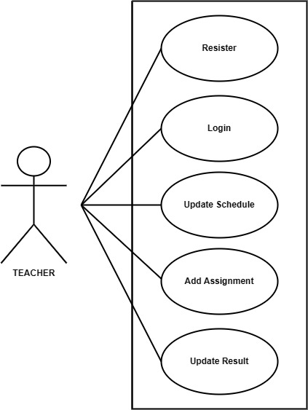

Slide 8
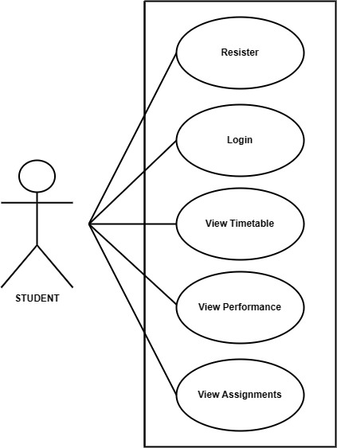

Slide 9
Technology platform used
Technologies used :
HTML, CSS, JavaScript, jQuery, ReactJS, JSON, Spring boot, Hibernate, MySQL
Reason :
Html, CSS and JavaScript are used for frontend part for static web pages.
React JS is used for rendering the dynamic web pages and to create a single page application where only particular part of web page is rendered without altering complete web page.
Spring boot is used for server side processing wherein in connection with database is established from server and required data is manipulated and sent to client side.

Slide 10
User roles and responsibilities
User Roles :
There are four most important roles assigned to users. Like Admin User, Artist User, Customer User, and Corporate User.
Admin : User creation, permissions, reports generations, and management etc.
Teacher : Will add course related information and like assignments daily schedule and upload online test.
Student : Will be able to see the assignments, performance and result.
User Case According to roles :
Admin : Allowing access to user, track reports etc.
Teacher : Upload daily schedule and course material.
Student : Can see all the course material and daily schedule.

Slide 11
Details of contribution from each team member
Shantanu Mundhe: Implemented the Admin use case, Frontend Design.
Sushil Chaudhari : Implemented the Teacher use case, Frontend Design.
Shailesh Agarmore : Implemented Student use case, Frontend Design.
Pranav Chirame : Implemented UI part and Database.
Stages at which Coordination was needed
Most of the coordination was needed when complete UI needed to be rendered using React,
Every one worked together for designing the database

Slide 12
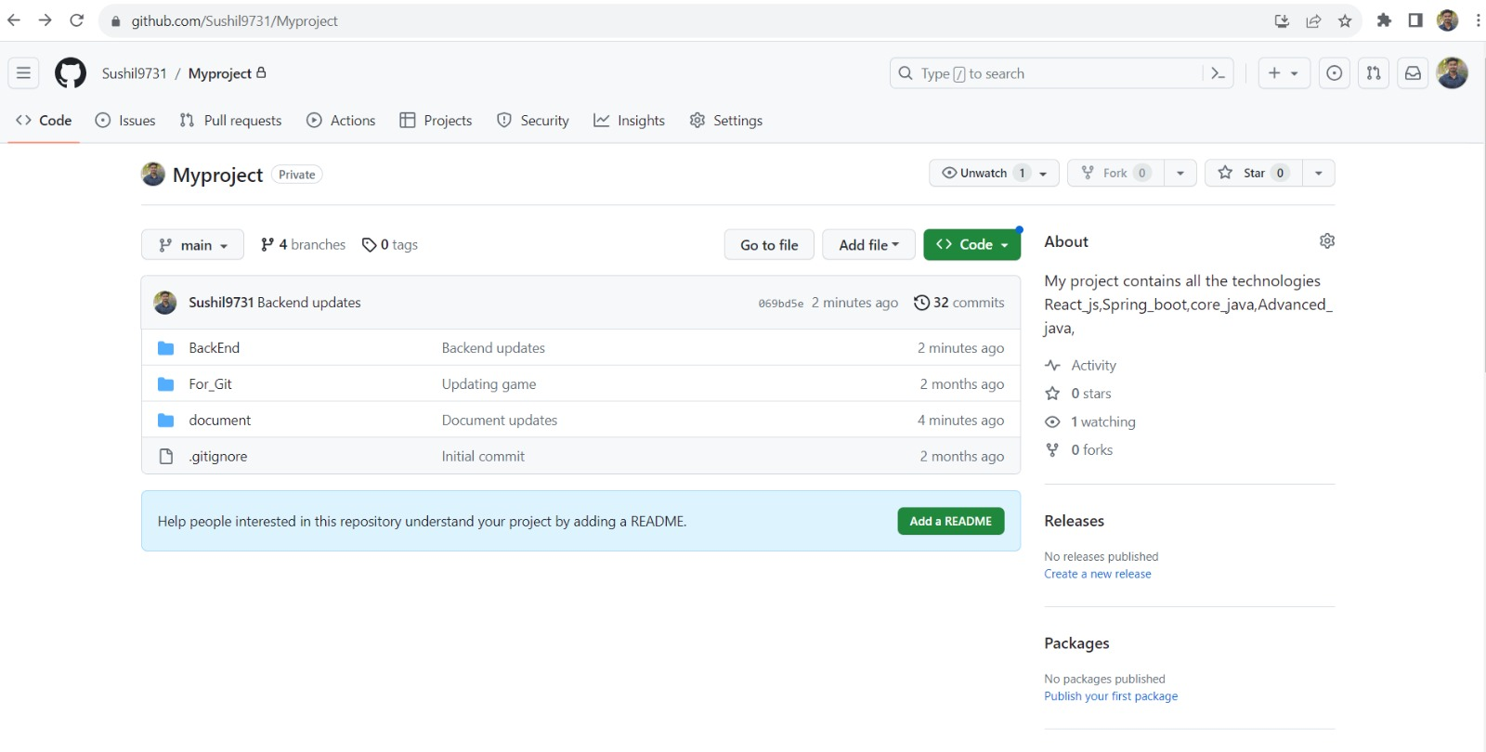
Use of Github
GitHub Link:
https://github.com/Sushil9731/Myproject.git.

Slide 13
Conclusion
Challenges you faced :
There were many challenges that we faced like finding a write path to start with, exploring the technologies beyond the horizon of our course and UI part Etc.
Things Learnt :
We have learnt to efficiently distribute the task within the team. We have learnt to combine all the dynamic stack of technologies together to create a fully functional software.
Overall Experience :
Overall experience was very practical oriented and highly knowledgeable and definitely it will helps a lot in future point view.

Slide 14
THANK YOU

